Slide 1
Media Art 206 Midterm Presentation galaxy screensaver
Luyao Wang
NetID: lw337

Slide 2
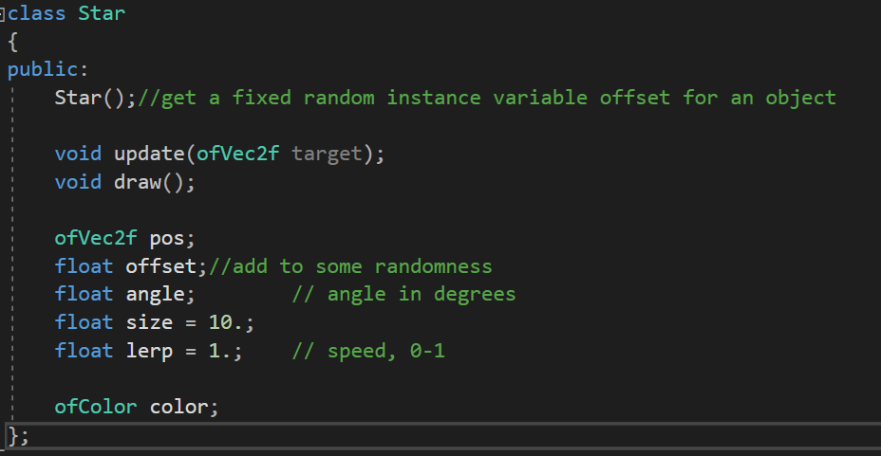
Class star
Draw a single little triangle
adapted from week 02 class 04 sample code "followers“ but not that regular

Slide 3



Class star
Draw a single little triangle
adapted from week 02 class 04 sample code "followers“ but not that regular
before
After
(ofSetBackgroundAuto disabled)

Slide 4
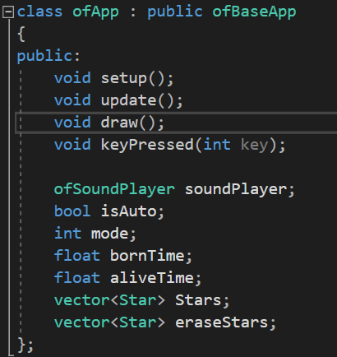
Class ofApp

Slide 5
Class ofApp
Auto draw & Manual draw
Vector Stars: to store stars
Vector eraseStars: in auto draw mode, when a screen has been drawn for more than 60 seconds, a brush is going to erase some of the stars to keep the screen clean (implemented by drawing white stars)

Slide 6
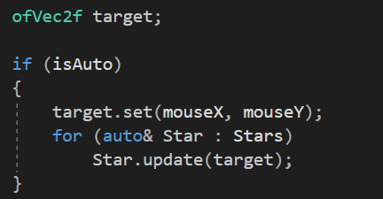
galaxy screensaver
Auto draw
Manual draw
Lissajous-Figure for auto draw

Slide 7
Three modes
Galaxy mode
Upbeat mode
Sentiment mode
different background music

Slide 8
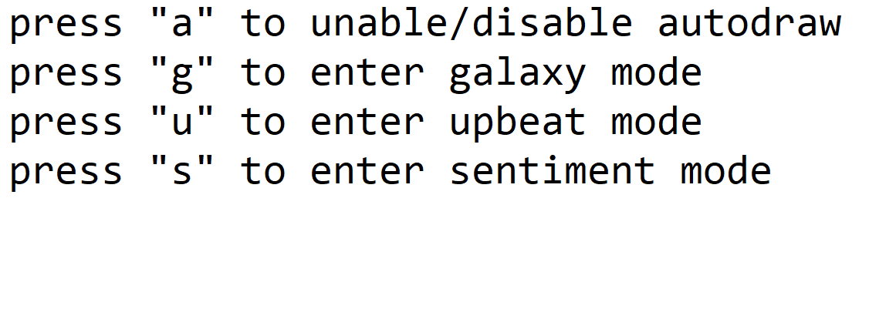
guide

Slide 9
Demostration
thanks

